Slide 1

BLOOD BANK MANAGEMENT SYSTEM

Slide 2

Introduction
The purpose of this project is to create a software solution that can help manage blood donations and distribution in a more efficient and effective manner. We decided to build this system because we recognized the challenges that blood banks face in managing their inventory and ensuring a steady supply of blood for patients in need.
Our blood bank management system is designed to be helpful for a variety of audiences, including blood bank administrators, healthcare professionals, and patients. For blood bank administrators, the system provides a centralized platform for managing blood donations, tracking inventory levels, and coordinating blood distribution to hospitals and clinics. For healthcare professionals, the system provides a streamlined process for ordering and receiving blood products, while also ensuring the safety and quality of the blood being transfused. And for patients, the system can help ensure that they receive timely and appropriate blood transfusions when needed.

Slide 3
Improved inventory management: Our system helps healthcare professionals manage blood product inventory levels more effectively. The system provides real-time inventory tracking and management, which helps to prevent stockouts and ensure that blood products are available when needed. This also reduces waste by minimizing the likelihood of expired blood products.
Overall, our blood bank management system provides healthcare professionals with a more efficient and effective way to manage blood product orders and inventory, while also ensuring the safety and quality of blood products being transfused. This can help improve patient outcomes and reduce the burden on healthcare professionals, allowing them to focus more on patient care.

Slide 4
Features
Our blood bank management system is a comprehensive software solution that provides a wide range of features to help blood banks manage their operations more efficiently and effectively. Here are some of the main features of our system:
Donor management: Our system includes tools for managing donor information, such as donor demographics, medical history, and donation history. This allows blood banks to track donor eligibility and ensure that donated blood is safe and of high quality.

Slide 5
Features
Inventory management: Our system provides real-time inventory tracking and management, which helps blood banks manage their blood product inventory more effectively. The system includes tools for tracking blood product types, quantities, and expiration dates, as well as automatic alerts for low inventory levels.
order management: Our system provides a streamlined process for healthcare professionals to order and receive blood products. Healthcare professionals can easily place orders for specific blood products and track their delivery status in real-time.

Slide 6
Features
Distribution management: Our system includes tools for coordinating the distribution of blood products to hospitals and clinics. It includes features for managing product transport, temperature monitoring, and delivery tracking.
Reporting and analytics: Our system includes built-in reporting and analytics tools that provide blood banks with insights into their operations. Blood banks can generate reports on donor demographics, donation history, inventory levels, and more.

Slide 7
Features
Mobile app: Our system also includes a mobile app that allows healthcare professionals to access the system on-the-go. The app includes features for ordering blood products, tracking deliveries, and managing patient information.

Slide 8
ARCHITECTURE
The blood bank management system is built using a layered architecture.
The architecture is based on the separation of concerns (SoC) and single resposibility principle (SRP) design patterns.
The application is divided into three layes: presentation, business and data access.

Slide 9
ARCHITECTURE Cont…
1-Presentation layer
The presentation layer is resposible for presenting the user interface to the user.
The layer is built using C# WinForms, a popular UI framework for building windows desktop application.
The presentaions layer implements the user interface using a set of UI controls such as buttons, textboxes, datagrid, and other controls.
The presentation layer is responsible for handling user input and forwarding it to the business layer.

Slide 10
ARCHITECTURE Cont…
2-Business layer
The business layer contains the business logic and rules of the application.
The layer is built using C# and implements the core functionality of the application.
The business layer implements the rules and logic related to blood donation eligibilty, inventory management, and user management.
The business layer is responsible for interacting with the data access layer to retrieve and store data.

Slide 11
ARCHITECTURE Cont…
3-Data accesses layer
The data access layer is responsible for interacting with the database.
The layer is built using ADO.NET, a data access technology in .Net.
The data access layer implements the data access logic such as CRUD operations, data mapping, and database connection management.
The data access layer is responsible for interacting with the SQL server database to store and retrieve data.

Slide 12
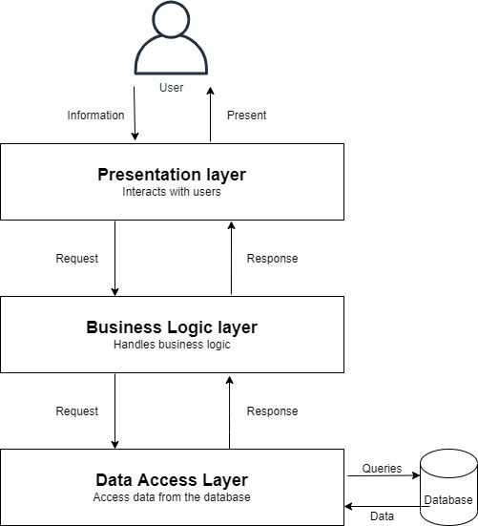
ARCHITECTURE Cont…

Slide 13
TECHNOLOGIES USED
ADO.NET was used for building the data access layer.
SQL Server was used as the database management system.
C# WinForms was used for building the presentation layer.
Microsoft word was used for generating reports.

Slide 14
TECHNOLOGIES USED Cont..
1-SQL SERVER
SQL server is reliable and widely used database management system that provide advanced features for managing data and improving performance.
SQL server was used in BBMS as a primary database management system.
The database contains tables for storing blood inventory, donor information, user accounts, and other related data.

Slide 15
TECHNOLOGIES USED Cont..
2-ADO.NET
ADO.NET is a data access technology in .NET that provide a flexible and efficient way to connect to databases.
ADO.NET was used in the data access layer of BBMS to interact with the SQL server database.
ADO.NET provides a set of classes and APIs for performing CRUD operations, data mapping, and database connection management.

Slide 16
TECHNOLOGIES USED Cont..
3-C# WINFORM
C# WinForms is a popular UI Framework for building windows desktop applications.
The framework provides a rich set of UI controls such as buttons, textboxes, datagrid, and other controls.
C# WinForms was used extensivly in building the user interface of the BBMS.
it provides an easy-to-use drag-and-drop interface and supports data binding and validation.

Slide 17
TECHNOLOGIES USED Cont..
4-MICROSOFT WORD
Microsoft word was used for generating reports in BBMS.
The reports provide valuable information such as blood inventory level, donor statistics, and other matrics.
Microsoft word is a powerful tool that allows for the creation of complex reports using a visual design interface.
The reports were designed using custom templates and data was extracted from the database using ADO.NET. Microsoft word provides a flexible and efficient waay to generate reports in various formats, such as PDF, Word documents.

Slide 18
CONCLUSION
The blood bank management system is a reliable and efficient system for managing blood bank operations.
The layered architecture provide a clear separation of concerns between presentation, business and data access.
The technologies used in the project as ADO.NET, SQL server, C# WinForms, Microsoft Word, provide a robust and efficient platform for building desktop applications.
BBMS provides efficient blood donation management, accurate tracking of blood inventory and improved user management and access control.

Slide 19

User Interface

Slide 20

Future Improvements
Blood group detection
using image processing has several potential benefits for blood bank management systems, including:
Faster blood typing: Automating the blood typing process using image processing could potentially be faster than manual blood typing methods, which can take several minutes to complete.
Improved accuracy: Image processing algorithms can be highly accurate, potentially reducing the risk of errors in blood typing.
Increased efficiency: Automating the blood typing process could help to reduce the workload on blood bank staff, allowing them to focus on other tasks.

Slide 21
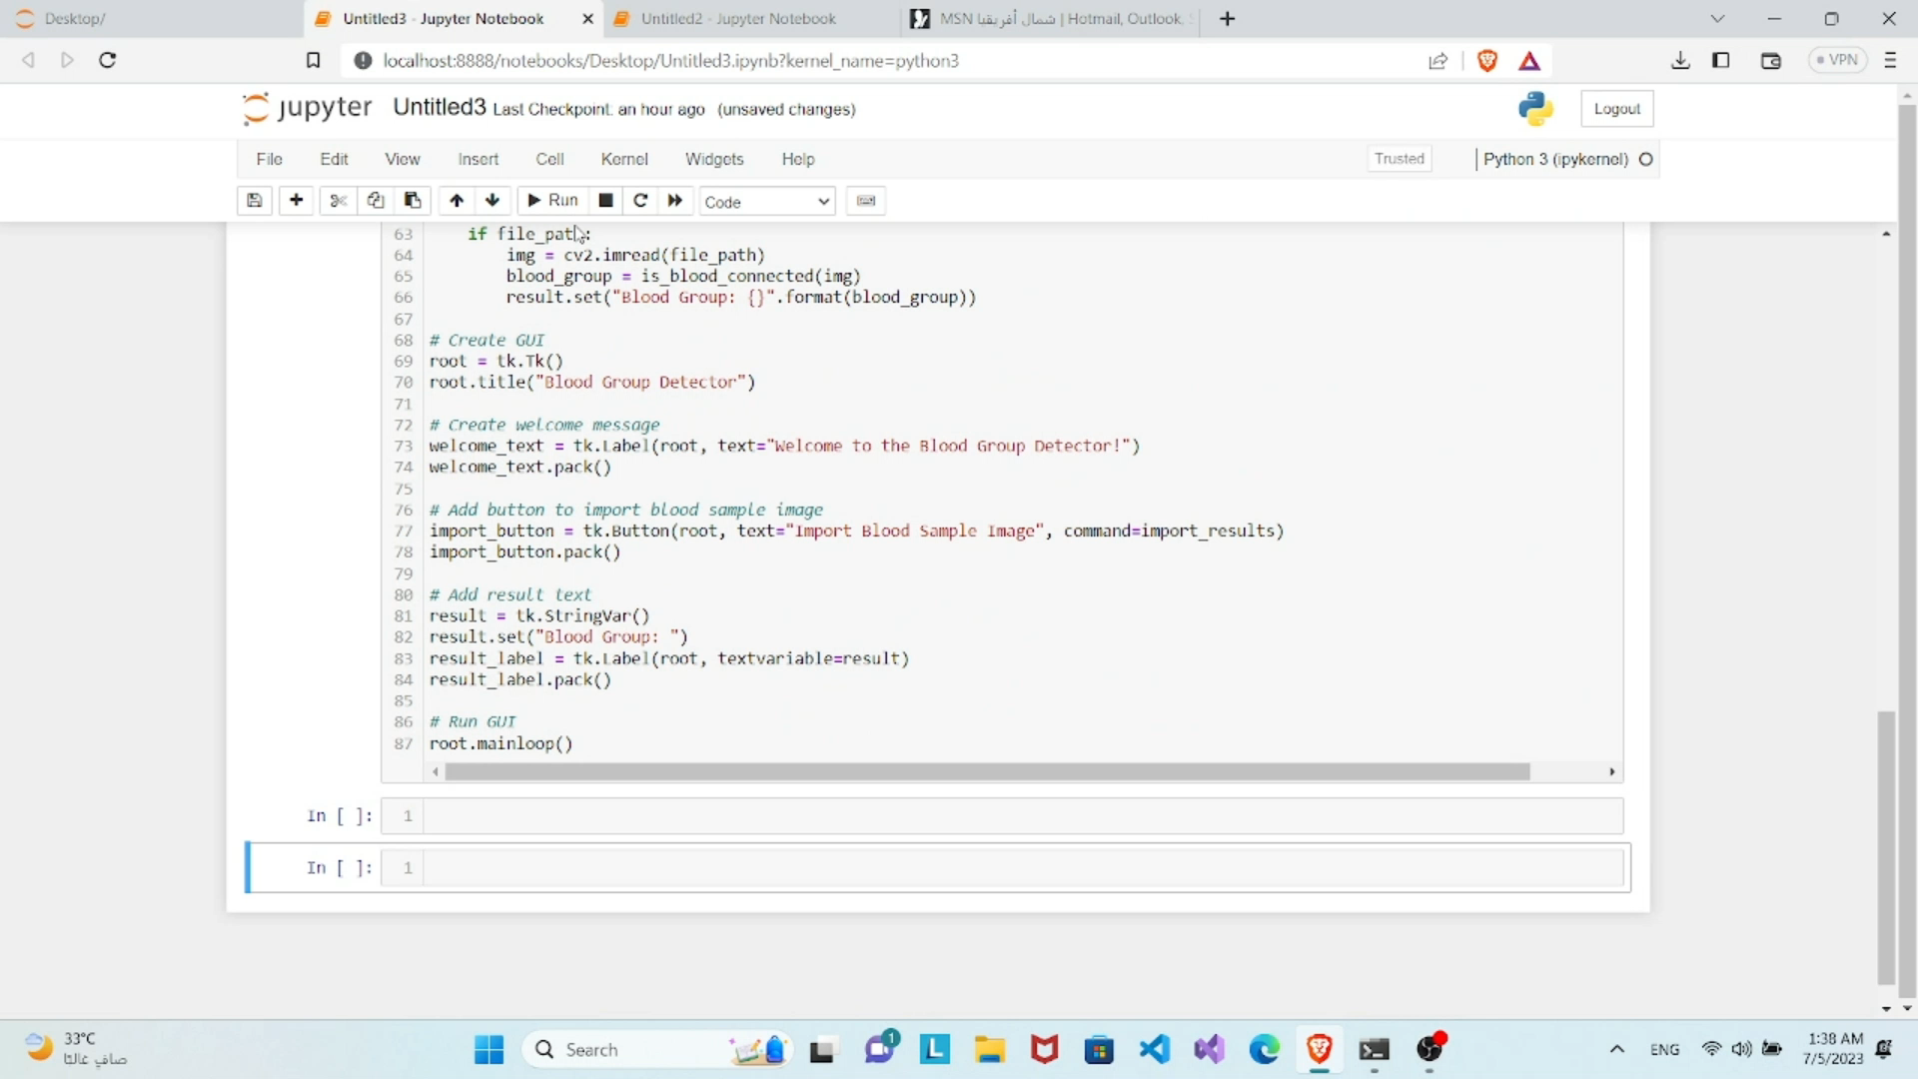
Prototype to Blood Group Detection

Slide 22
Future improvements
Inventory management: AI can be used to help blood banks manage their inventory of blood products more efficiently. For example, algorithms could be developed to prioritize which blood products should be used first based on factors such as expiration dates, demand, and testing results.
Improved blood testing: AI could be used to develop new and more accurate blood testing methods. For example, machine learning algorithms could be trained to identify subtle changes in blood samples that might indicate the presence of certain diseases or conditions.
Predictive analytics: AI can be used to analyze large amounts of data from past blood donations and predict future demand for specific blood types based on factors such as location, time of year, and population demographics. This could help blood banks better anticipate and prepare for shortages or surpluses of certain blood types.

Slide 23
Demonstration

Slide 24
User fedback:
According to the User’s fedback, the suggested Blood Bank Management System could handle the various scenarios examined effectively and efficiently. When compared to manual methods, the time required to complete a given activity was much shorter, and the accuracy of the data entered the system was high. Users also expressed great satisfaction with the system, saying that it was simple to use and promptly delivered the data they required

Slide 25
Deployment
1-Installation
The installation process should be simple and straightforward, and it should require minimal user intervention.
The installation process should also be well documented, with step-by-step instructions that are easy to follow.
2-Configuration
Once the application is installed, it must be configured to work with the database management system and other components of the system.
The configuration process should be well documented, with clear instructions on how to configure the application for optimal performance and security.

Slide 26
3-Testing
After the application is installed and configured, it should be thoroughly tested to ensure that it is functioning correctly and that it meets the requirements of the end-user.
Testing should include functional testing, usability testing, and performance testing, among other types of testing.
4-Support
After the application is deployed, it is important to provide ongoing support to end-users.
This may include training, and maintenance services.
The support services should be well documented, with clear instructions on how to access support and who to contact in case of any issues.

Slide 27
﻿security
User Authentication and Authorization
Application security relies on user authentication and authorization. Valid login credentials and role-based access control (RBAC) ensure users access only authorized features and data based on their roles.
Data Privacy:
The application is designed to protect the privacy and confidentiality of sensitive data, such as donor information and medical records
Backup and Recovery
The application must have backup and recovery procedures in place to prevent data loss in case of system failure. These procedures should be stored securely and regularly tested for effectiveness.

Slide 28
Maintenance and Support
Create a maintenance schedule for frequent application updates, bug fixes, and performance checks to ensure regular updates and maintenance.
Regularly backup applications and data to prevent data loss in system breakdowns. Test backup techniques and store them securely to ensure proper functionality.
we provide simple training to help users understand how to use the application effectively.

Slide 29
Conclusion
A desktop application for managing a blood bank using C# programming and SQL Server provides an efficient solution for handling donor and inventory information, transfusion requests, and other elements. It is reliable, safe, and user-friendly, satisfying stakeholder needs like healthcare professionals, donors, and patients. By focusing on maintenance, support, deployment, security, and user feedback, the application can support public health initiatives and improve patient care for vital blood transfusions.

Slide 30
Team Member :-
Mohamed Mamdouh Allam.
Ahmed Ali Mahmoud.
Mai Mohamed Elsayed.
Zeinab Alaa Shaaban.
Yasmine Hossam El Din.
Sammar Alaa El Din.

Slide 31
Thank you

